Slide 1
Protozoa
INTRODUCTION

Slide 2
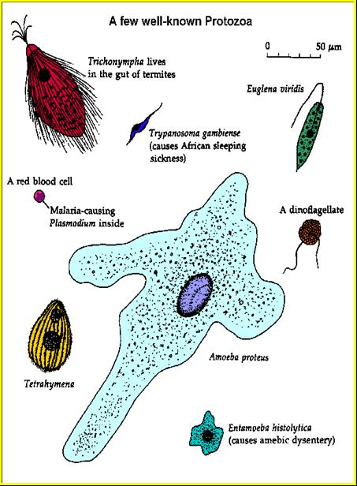
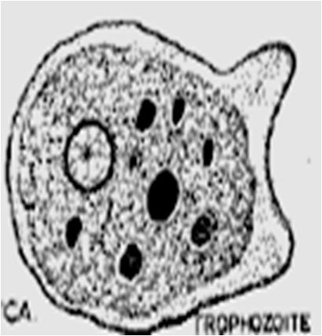
General Characteristics of Protozoa
Single-celled eukaryotic microorganisms capable of performing all functions of life.
Morphology: wide variety (from amorphous to well defined)
Structure: mass of protoplasm differentiated into outer ectoplasm (protection, locomotion, respiration, nutrition) and inner endoplasm (metabolism functions) enclosing a nucleus (regulation of cell activities & Reproduction).
Locomotion: by pseudopodia, flagella, cilia, or immotile.
Nutrition: feed by diffusion of soluble material, phagocytosis, pinocytosis, or by a cytostome.
Excretion: by diffusion or rarely by contractile vacuoles.
Secretion: of digestive enzymes, toxins, antigenic substances, and cyst wall material.
Life cycles: variable, from few stages to very complicated.

Slide 3
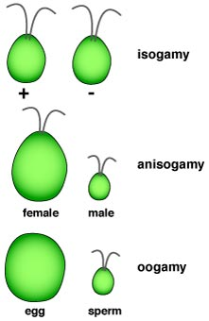
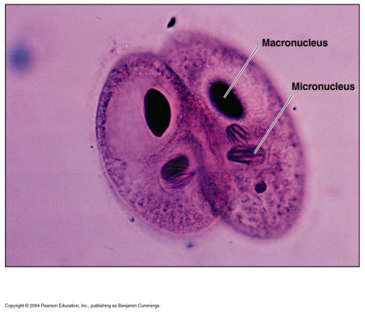
Reproduction of Protozoa
Asexual Reproduction:
Sexual Reproduction:
. Binary fission
. Syngamy (fusion of gametes):
. Budding (gemmation)
. Schizogony (multiple fission)
. Conjugation (temporary pairing with exchange of nuclear material)
. Endodyogeny (eg. Toxoplasma sp.)

Slide 4
Living conditions of Protozoa
Pathogenic protozoa: Protozoa that exist in human body and cause harm to infected human.
Commensal protozoa: Protozoa that exist in human body but does not cause harm to infected human.
Opportunistic protozoa: weak protozoa that cause minimal effect to infected healthy man but has severe effect on infected immuno-compromized persons.
Potentially pathogenic free-living protozoa: free-living in nature away from man but some of them may cause disease if they enter accidentally man body by certain route.

Slide 5
Protozoa can be classified by their mode of motility (movement):
Subgroup | Mechanism of motility
amebae | movement ameboid
flagellates | flagella
ciliates | cilia
sporozoa | gliding motility

Slide 6
Classification & Species list of some protozoan parasites in humans
Protozoa
Ameba
Flagellates
Ciliates
Apicomplexa
Others
Intestinal
Intestinal
Free living
Balantidium coli
Entamoeba histolytica
Entamoeba coli
Entamoeba gingivalis
Endolimax nana
Iodamoeba butschlii
Naegleria fowleri
Acanthamoeba spp.
Coccidia
Toxoplasma gondii
Sarcocystis spp.
Isospora belli
Cryptosporidium spp.
Blood & Tissues
Trypanosoma spp.
Leishmania spp.
Malaria
Intestinal & Urinogenital
Plasmodium falciparum
Plasmodium vivax
Plasmodium ovale
Plasmodium malariae
Giardia lamblia
Trichomonas hominis
Trichomonas vaginalis

Slide 7
Intestinal Protozoa

Slide 8
Intestinal protozoa of medical importance
Pathogenic:
Entamoeba histolytica (amoeba / large intestine)
Balantidium coli (ciliate / large intestine)
Giardia lamblia (flagellate / small intestine)
→ Dysentery
Opportunistic:
Cryptosporidium parvum (small intestine)
Cyclospora cayetanensis (small intestine)
Isospora belli (small intestine)
Microsporidia (small intestine)
→ Diarrhea
Commensals:
Several species.

Slide 9
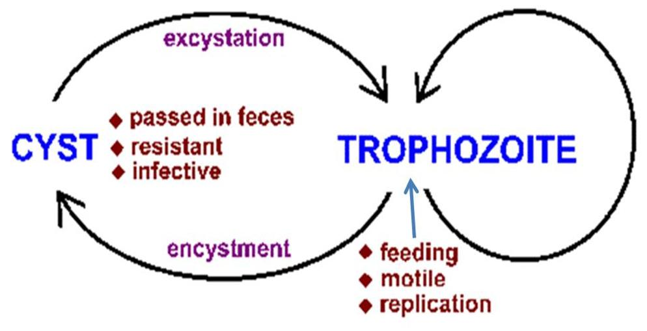
Typical life cycle of intestinal protozoa
Fecal-oral transmission: humans get infected through ingestion of water/food contaminated with parasites’ cysts.

Slide 10
Epidemiology
Entamoeba histolytica → Amoebiasis is cosmopolitan with high prevalence (up to 25% in some areas) in tropical & subtropical developing countries where transmission is extensive because of poor sanitation, poverty and overcrowding. But, it is estimated that only 10% of infected people are symptomatic (have dysentery) & 90% are asymptomatic (carriers). Mortality is ~ 100.000 annually.
Balantidium coli → Balantidiasis is cosmopolitan, but more prevalent in warmer climates and pig raising countries.
Giardia lamblia → Giardiasis occurs worldwide, but is more prevalent in regions with poor hygiene, particularly of water sanitation. It is known to cause epidemic, endemic or traveler’s diarrhea. Transmission also occurs by person-to-person contact (eg. in day care centers), and is more common in children.

Slide 11
Epidemiology (cont.)
Cryptosporidium parvum → Cryptosporidiosis is cosmopolitan and considered as one of the three most common causes of diarrhea in the world. Risk groups include travelers to endemic areas, members and children of day care centers, and animal handlers. It is opportunistic and causes serious disease in immuno-compromised patients. Autoinfection occurs.
Cyclospora cayetanensis → Cyclosporiasis is cosmopolitan. Infections occur through ingestion of sporulated oocysts in food or drinks. Autoinfection does not occur.
Isospora belli → Isosporiasis is cosmopolitan. Occurs through ingestion of sporulated oocysts in food and water. Autoinfection may occur.

Slide 12
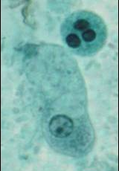
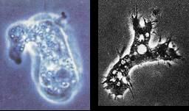
Amoebae of the alimentary canal
Entamoeba histolytica
Entamoeba coli
Entamoeba gingivalis
Endolimax nana
Iodamoeba butschlii
Free living amebae

Slide 13
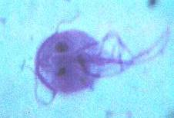
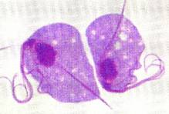
Flagellates of the digestive and urogenital tract
Giardia lamblia
Trichomonas hominis
Trichomonas vaginalis

Slide 14
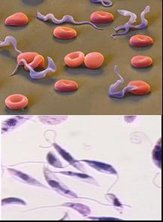
Blood and tissue flagellates and their vectors
Trypanosoma spp.
Leishmania spp.

Slide 15
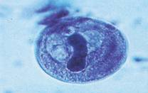
Intestinal ciliates
Balantidium coli

Slide 16
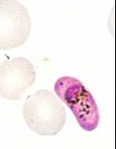
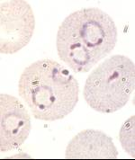
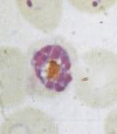
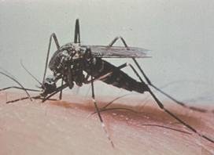
Malaria parasites
Plasmodium falciparum
Plasmodium vivax
Plasmodium ovale
Plasmodium malariae
. Mosquitoes are the vectors of malaria.

Slide 17
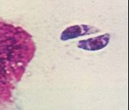
Toxoplasma parasites
Toxoplasma gondii

Slide 18
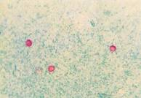
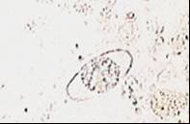
Others: Opportunistic parasites
Cryptosporidium spp.
Cyclospora cyatenensis
Isospora belli

